Slide 1
Covidcast:
Forecasting Aids for Delphi
August 11, 2021
Taha Bouhoun, Michelle Lee, Shilaan Alzahawi

Slide 2

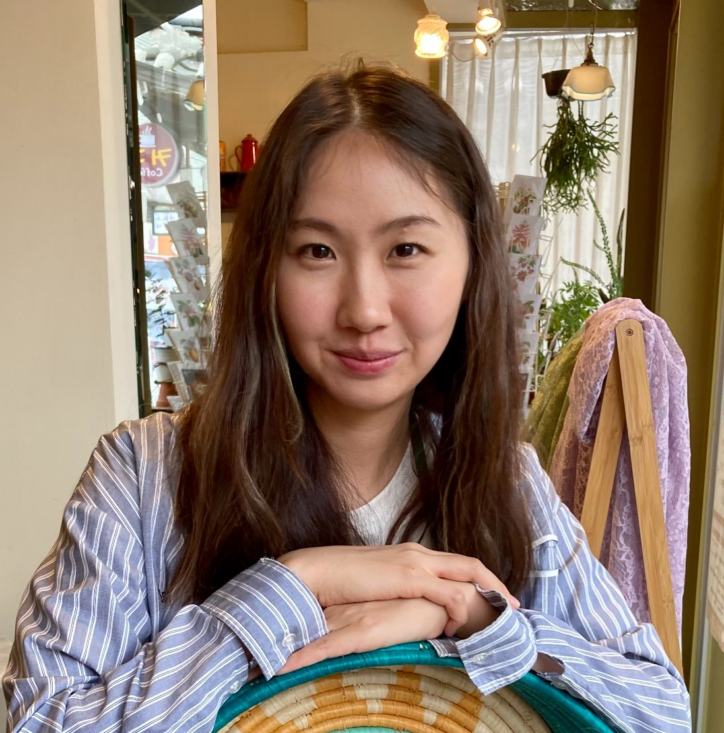



Covidcast: Forecasting Aids for Delphi
Taha Bouhoun
Minerva University
DSSG Fellow
Michelle Lee
Columbia University
DSSG Fellow
Shilaan Alzahawi
Stanford University
Technical mentor
Balasubramanian Narasimhan
Stanford University
Faculty mentor
Daniel McDonald
University of British Columbia, Canada
Faculty mentor

Slide 3
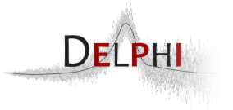
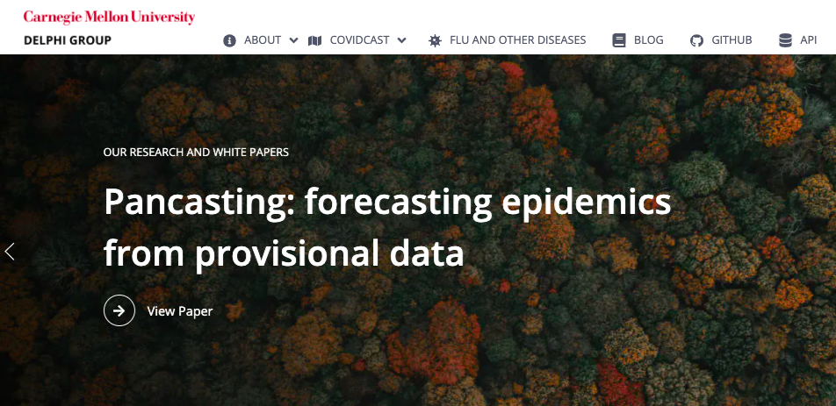
Delphi Research Group
The Delphi Research Group at Carnegie Mellon University and is one of the two influenza forecasters in the United States
The group’s goal is to develop the theory and practice of epidemiological forecasting
Prior to COVID-19, the group also worked on forecasting for influenza, dengue, and norovirus

Slide 4
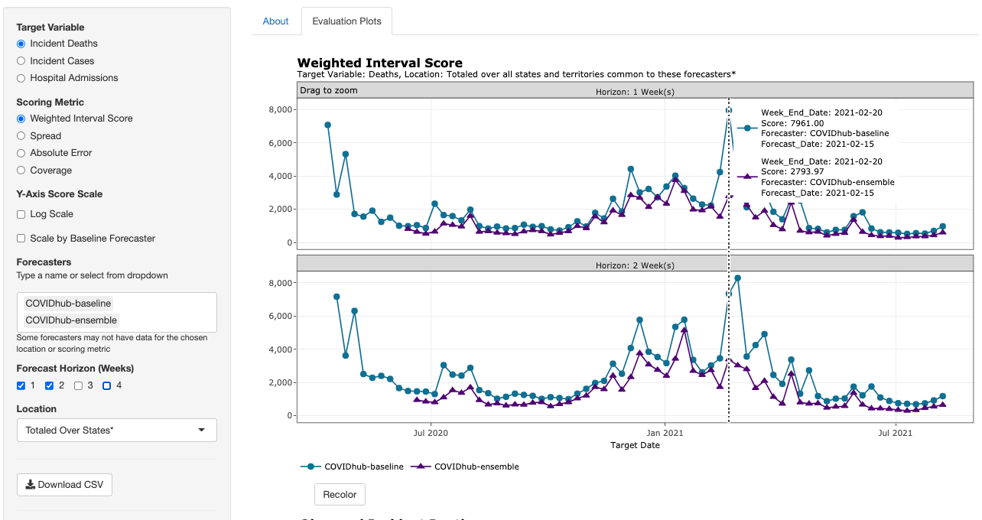
Delphi Covidcast
Since March 2020, the Delphi research group has maintained the largest public repository of real-time indicators of COVID-19 activity, through a public API.
Every Monday, the Delphi Covidcast generates forecasts of cumulative COVID-19 cases and deaths in the U.S. These predictions are reviewed by the team and sent to the CDC COVID-19 Forecast Hub

Slide 5
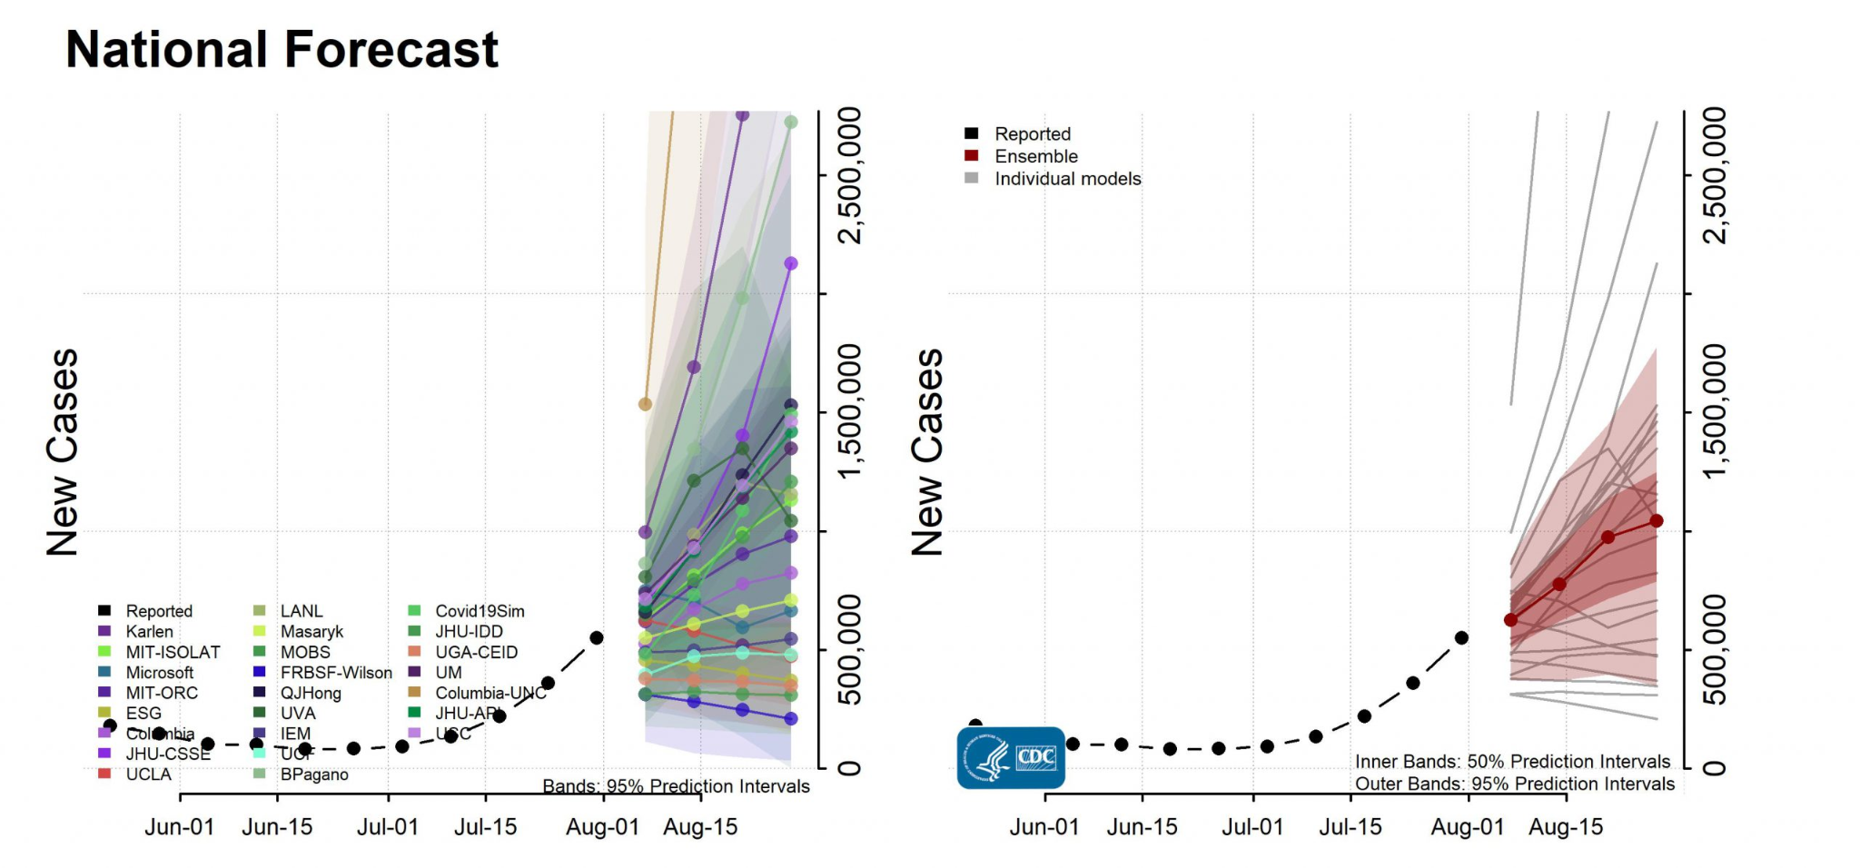
Source: Case Forecasts, CDC

Slide 6
What DELPHI would like to know
How does our (Delphi’s Covidcast) forecaster do compared to others?
Assess new forecasters before they are deployed
Are there periods of time that we do much worse or better?
Are there areas of improvement we need to focus on?
Our project involves the creation of a report that answers these questions

Slide 7

Goals & Deliverables
Our Goal
Develop tools for comparing and evaluating COVID forecasters
Our Deliverables
An interactive parameterized report that evaluates and compares the performance of several COVID-19 forecasters for cases, deaths, and hospitalizations
Along with the report, the user can download the underlying report-specific data
The user can automatically generate a report according to their chosen parameters
The number of epi-weeks ahead that the forecasts are made
The specific forecasters to compare to
Whether to use a colorblind-safe palette for generating the plots
A GitHub repository with fully documented code and vignettes

Slide 8
Outcomes of Interest & Data Sources
Covid-19 cases Number of daily confirmed cases reported by state and local health authorities
Covid 19- deaths Official figures of death due to COVID-19 as confirmed by health authorities
Covid-19 hospitalizations Daily Covid-19 related hospital admissions, estimated from health authorities’ aggregated statistics and patient data

Slide 9
Metrics to Evaluate Forecasting Performance
Weighted Interval Score (WIS) A proper score that combines a set of prediction interval scores. A smaller WIS indicates better performance
Coverage An estimate of the probability that a forecaster's 80% interval correctly includes the actual value
Absolute Error The difference between the actual value and the point forecast

Slide 10
Limitations of the Current Report
Too specific
API based:
Slow in knitting in R studio
Unable to run reports in case of API problems
Unable to personalize
Visually unappealing (many plots, colors of the graphs)

Slide 11
Project Architect: Generalizable Report
Choices
Modified
R Markdown
Knitted Report
Template

Slide 12
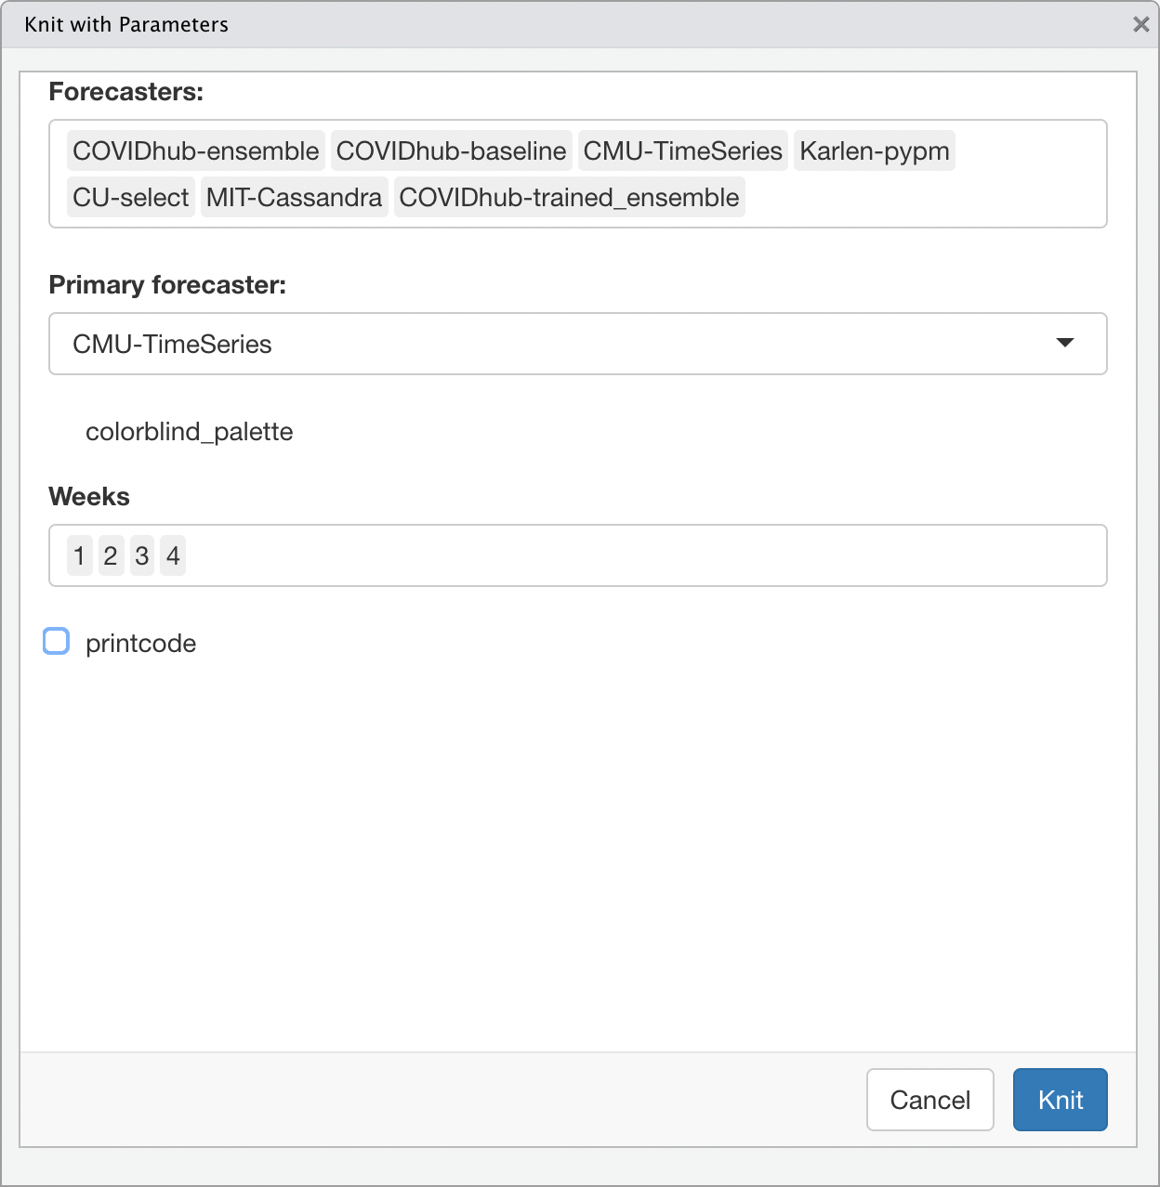
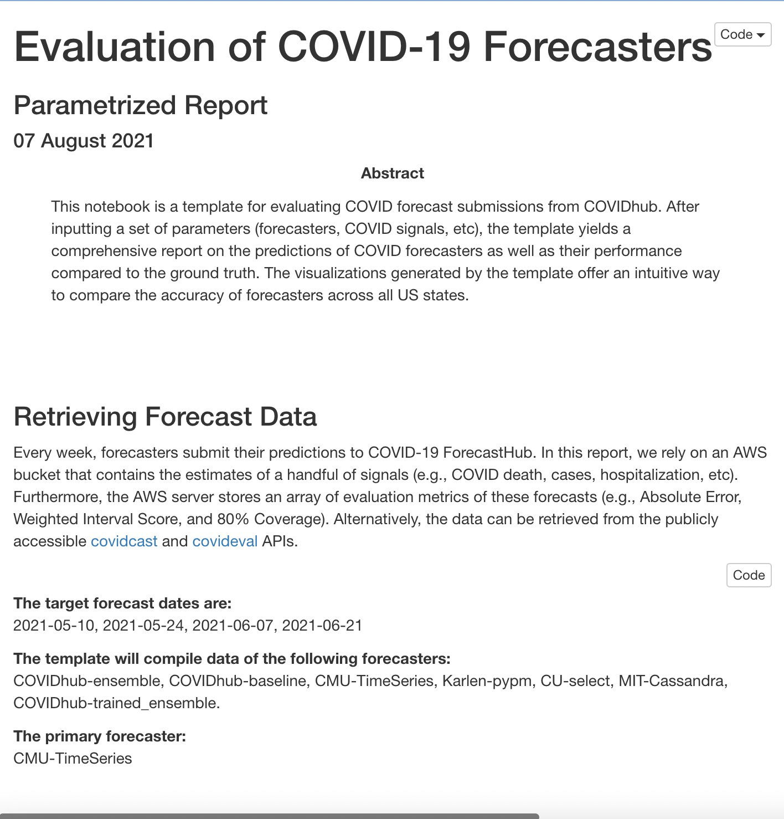
Functionality
Step 1 : Generate (cases, hospitalizations, or deaths) report with chosen parameters

Slide 13
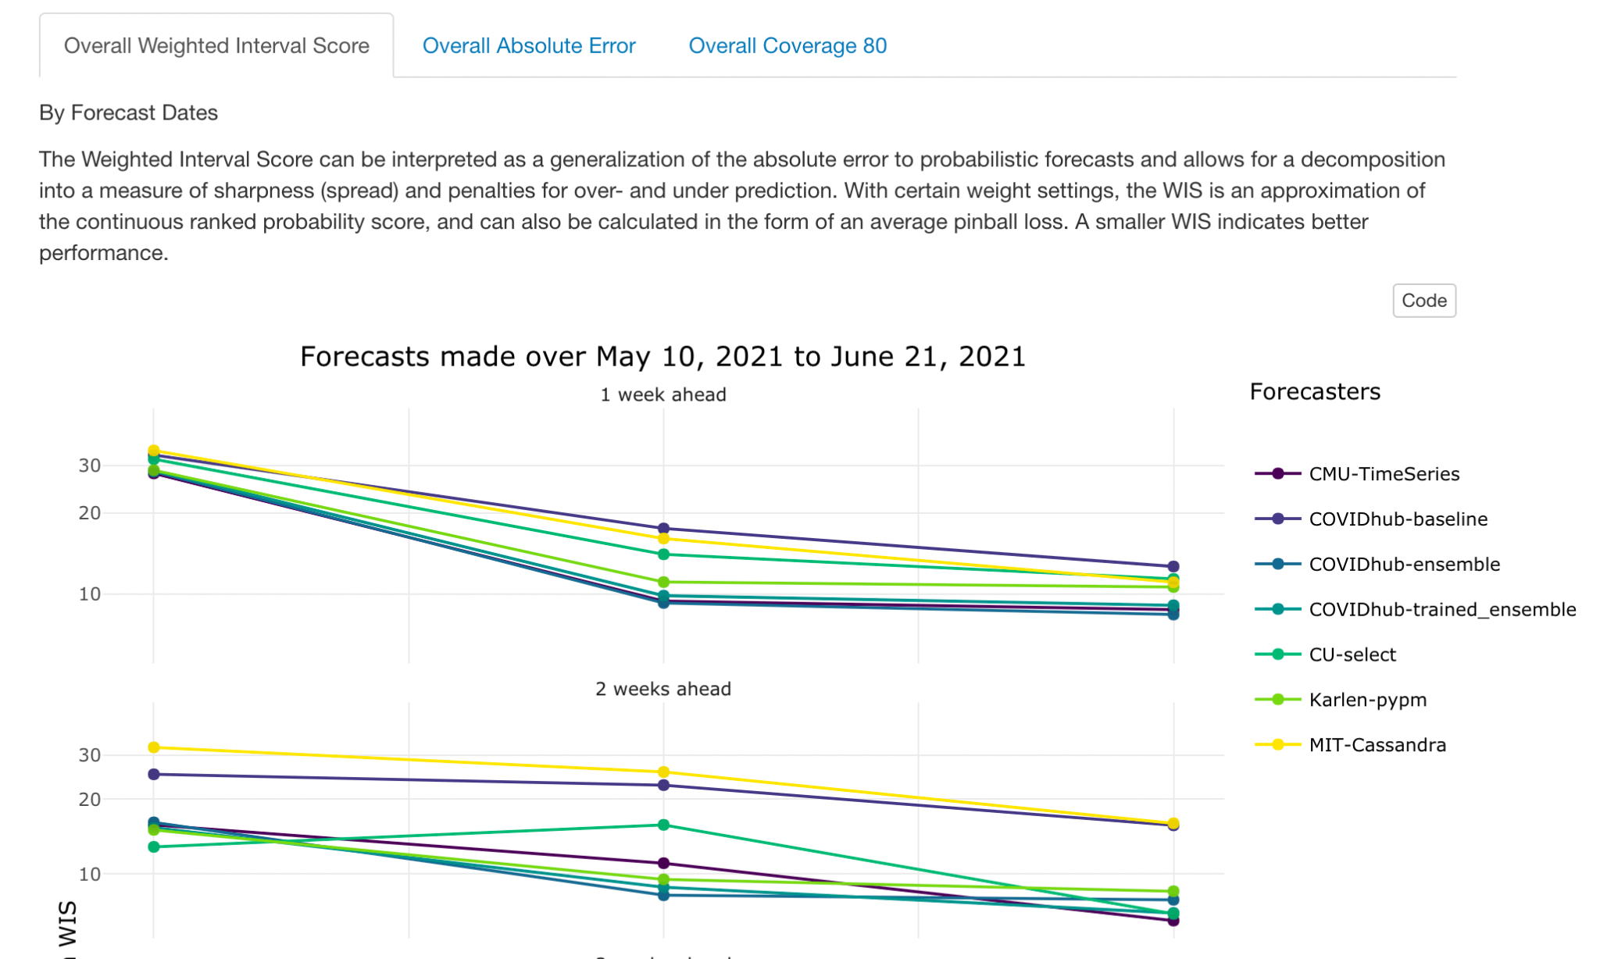
Functionality
Step 2: Explore interactive graphs in tabs

Slide 14
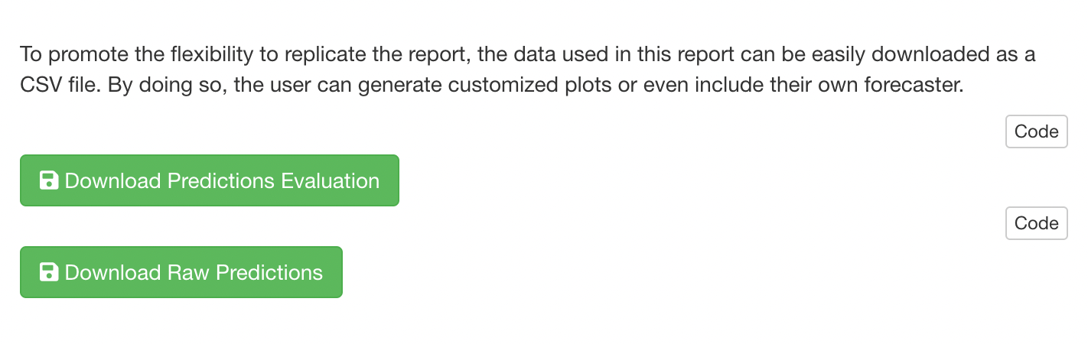
Functionality
Step 3 (optional): Download underlying data

Slide 15
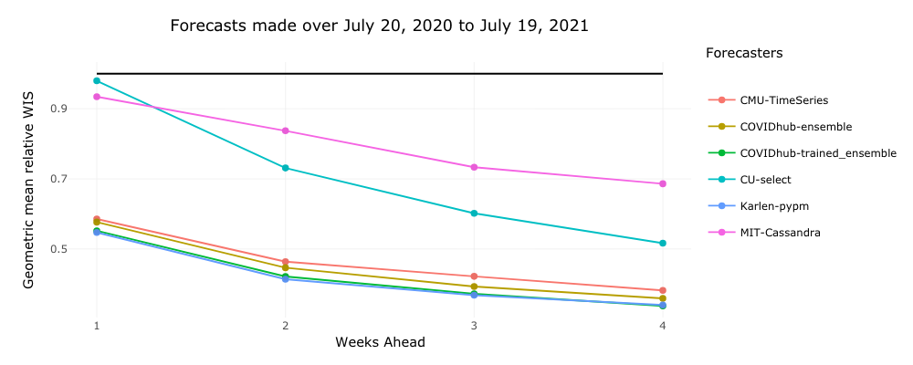
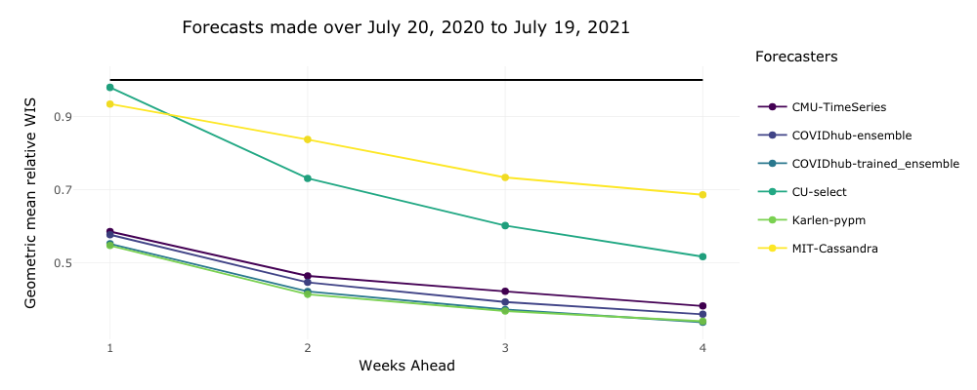
Colorblind-Safe Mode
Before:
After:

Slide 16
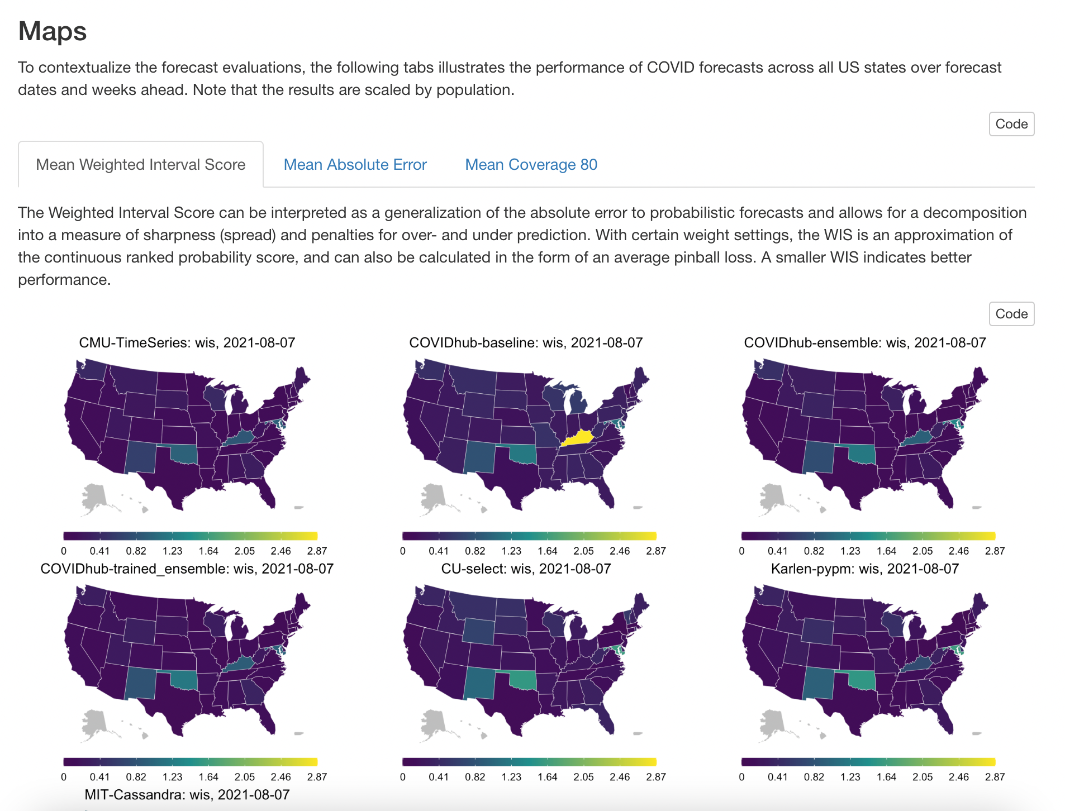
Identifying Discrepancies and Performances

Slide 17
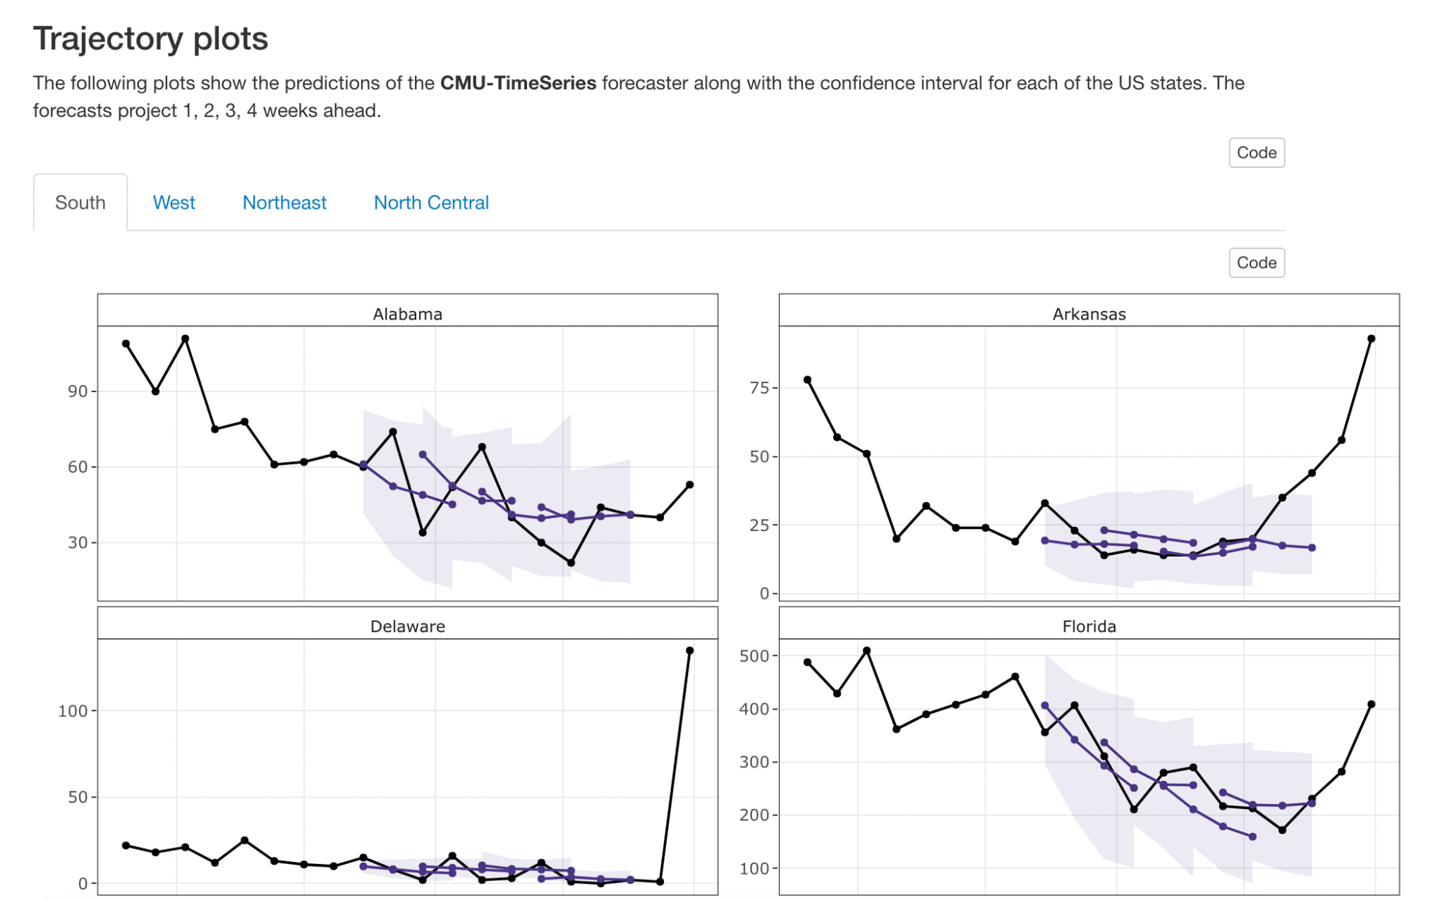
A look inside...

Slide 18
Limitations of the Original Report
Solutions
Too specific
API based:
Slow in knitting in R studio
Unable to run reports in case of API problems
Unable to personalize
Visually unappealing (many plots, colors of the graphs)
Use parameters and helper functions that can change the markdown parameters
Allow download of preformatted data from AWS bucket and prediction data frame (avoid API call)
Add better interactivity to plots
Organize the plots into tabs for easier navigation

Slide 19
Project Artifacts
Future Directions
Templated markdown files
Auxiliary R scripts for manipulating markdowns and generating reports
Example reports
A GitHub repository with fully documented code and vignettes
Shiny app that generates the report with the click of a button
County-specific forecaster performance
Docker solution for batch generation of reports

Slide 20


Thank you to our mentors and the DELPHI team !
Shilaan Alzahawi
Technical mentor
Balasubramanian Narasimhan
Faculty mentor
Daniel McDonald
Faculty mentor

